Slide 1
Data Representation and Organization
Logic Gates

Slide 2
Introduction
Digital systems are concerned with digital signals
Digital signals can take many forms
Here we will concentrate on binary signals since these are the most common form of digital signals
can be used individually
perhaps to represent a single binary quantity or the state of a single switch
can be used in combination
to represent more complex quantities

Slide 3
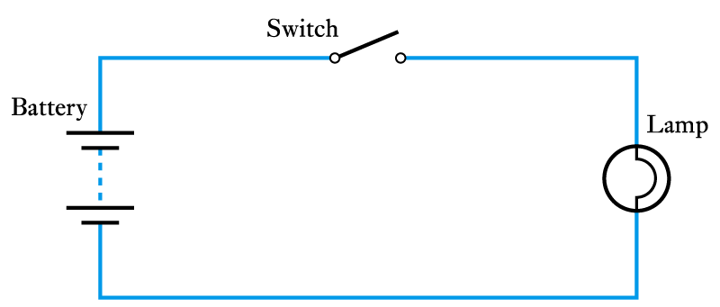
Binary Quantities and Variables
A binary quantity is one that can take only 2 states
S | L
OPEN | OFF
CLOSED | ON
S | L
0 | 0
1 | 1
A simple binary arrangement
A truth table

Slide 4
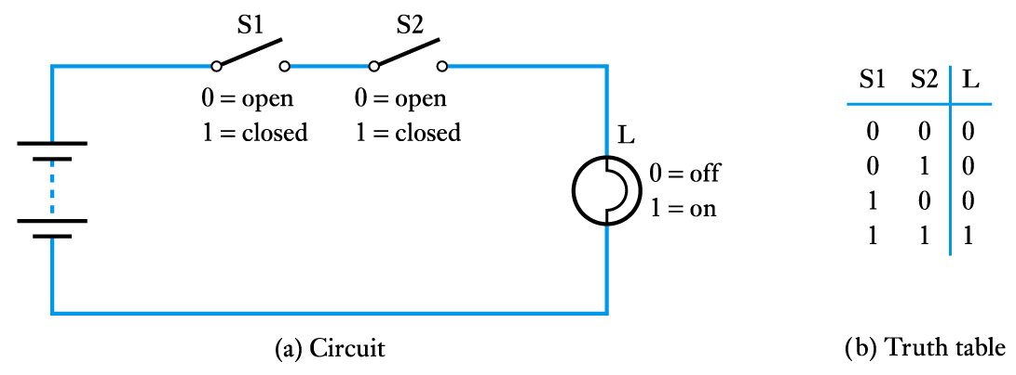
A binary arrangement with two switches in series
L = S1 AND S2

Slide 5
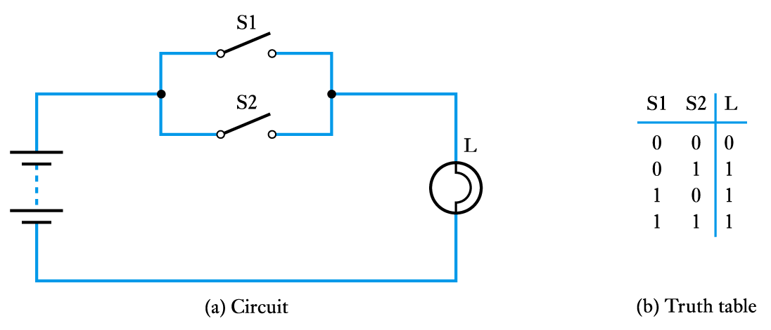
A binary arrangement with two switches in parallel
L = S1 OR S2

Slide 6
Logic Gates
The building blocks used to create digital circuits are logic gates
There are three elementary logic gates and a range of other simple gates
Each gate has its own logic symbol which allows complex functions to be represented by a logic diagram
The function of each gate can be represented by a truth table or using Boolean notation

Slide 7
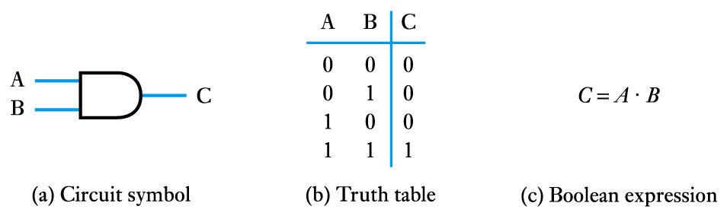
The AND gate

Slide 8
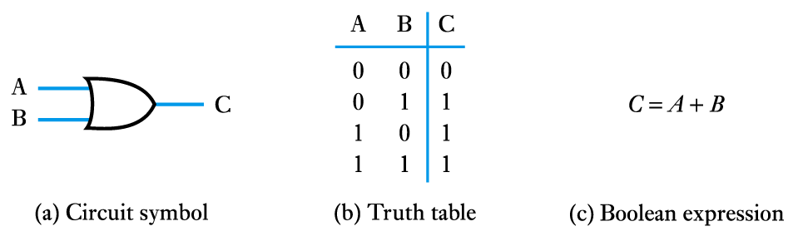
The OR gate

Slide 9
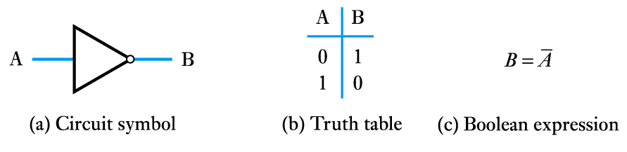
The NOT gate (or inverter)

Slide 10
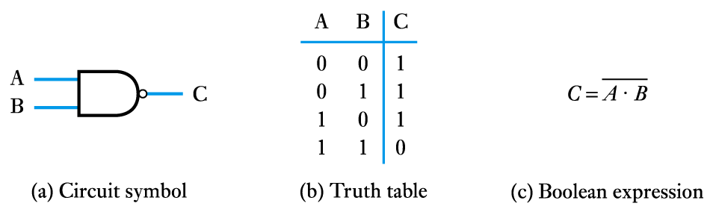
The NAND gate

Slide 11
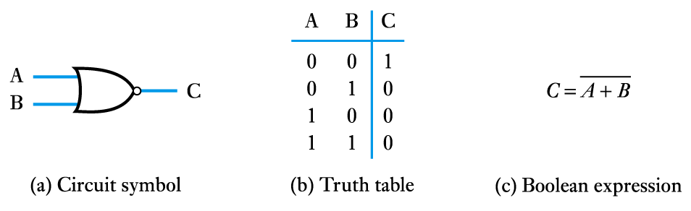
The NOR gate

Slide 12
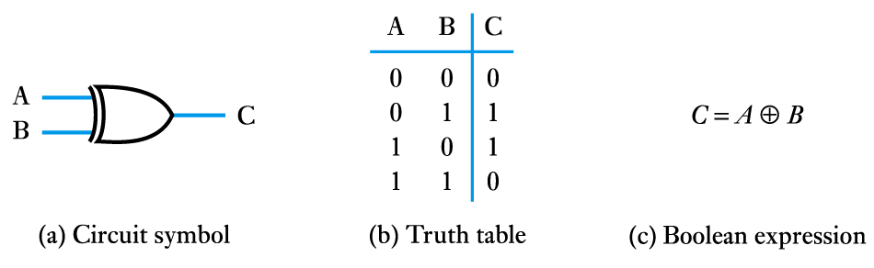
The Exclusive OR gate

Slide 13
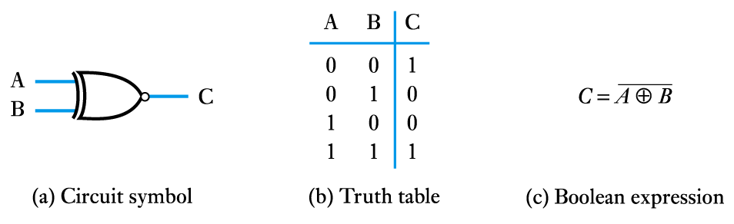
The Exclusive NOR gate

